Slide 1
Week 11/13

Slide 2
Overview of Work
Tyler worked more on the SYN flood, testing a script for DDoS, and thinks 5 Kali boxes may work for attacking docker.
Kaya worked on connecting pandapower and DSS via Helics, running into connection errors.

Slide 3
Work - Tyler
Response to Gelli’s question last week: I do not know. Current tests on a basic apache2 webserver are showing that it can take more than ~210 KiB/s of traffic (I had 3 metasploit instances running on my test VM, all running a basic synflood). Current theory is 5 should be enough at 6-8 cores each, all running multiple metasploit instances. It should generate over 1000 KiB/s, which I don’t believe a docker instance could handle, but I have yet to get that far in testing.
I have also started looking into rate limiting, though that seems to not go where I want it to. Upon talking with a cyber professor I TA for, most modern systems have safeguards against DoS attacks, like Ping of Death. DDoS might work better, but we might need to find a way to send massive malformed packets with a python script to overload the destination. I have a script I am currently testing.

Slide 4
Work - Zach
Continued developing the web server that will deploy attacks.
Did most of the work this week on my personal computer since we did not have the VMs, will transfer over this week before thanksgiving break.
Future work involves finishing integrating flask into attack web server as well as writing up some test code for a simple attack

Slide 5
Work - Justin
Found some important documentation and examples
https://github.com/NREL/dss-cosim
https://dss-extensions.org/dss_python/
Questions:
How do you use dss-python versus windows wrapper?
Command Line? API-Usage?
Not a ton of examples…
https://github.com/dss-extensions/dss_python/blob/master/docs/examples/JSON.ipynb

Slide 6
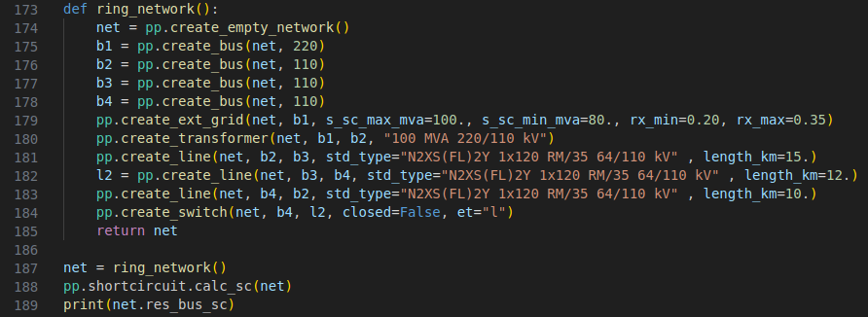
Work - Kaya
Working more on integrating pandapower and DSS
Questions:
Pandapower short circuit calculation, does it run after each simulation interval?

Slide 7
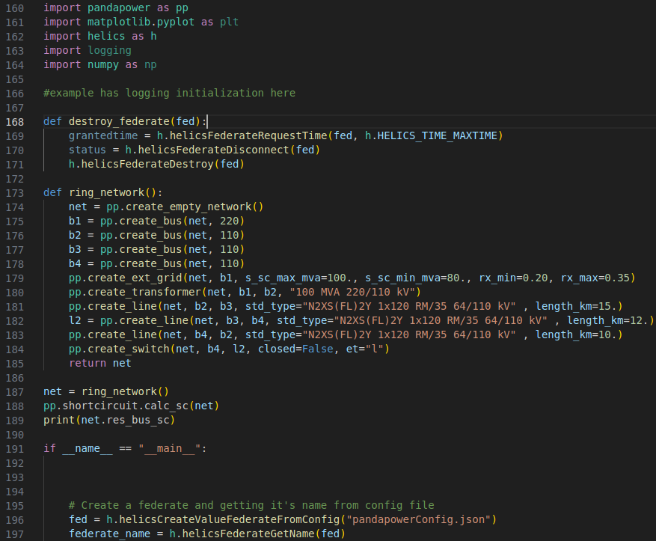
Pandapower Federate

Slide 8
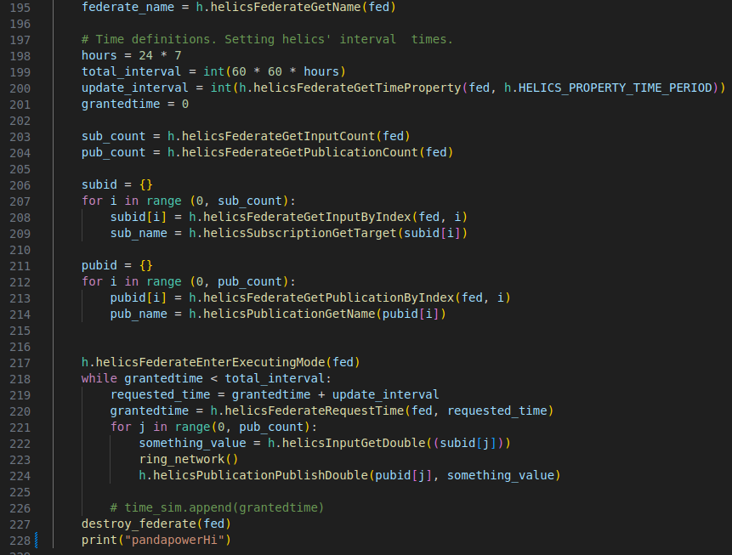

Slide 9
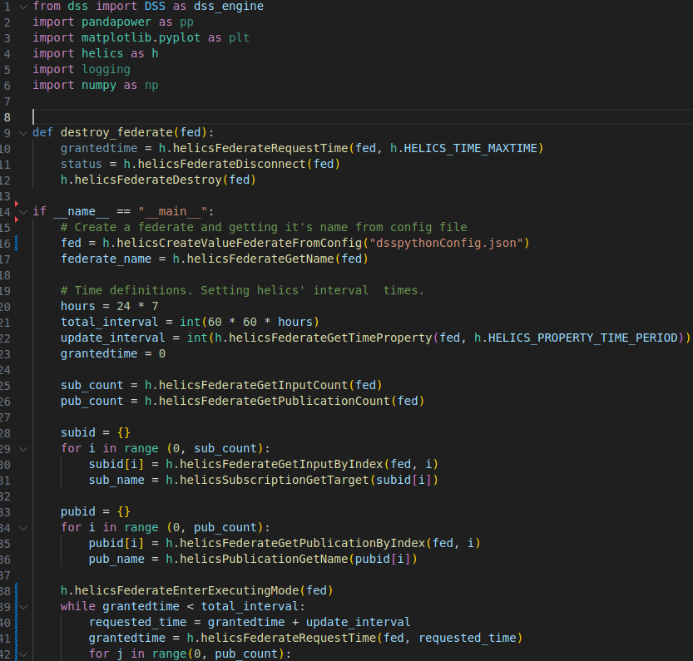
DSS Federate

Slide 11
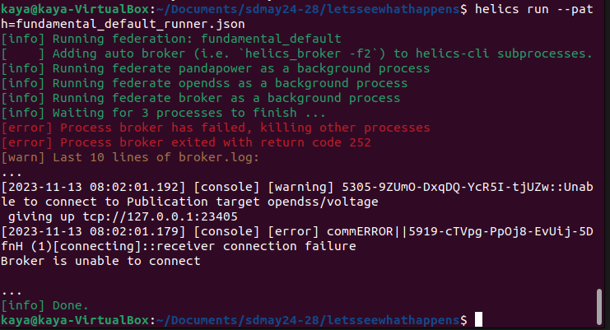
Cannot connect the federates

Slide 12
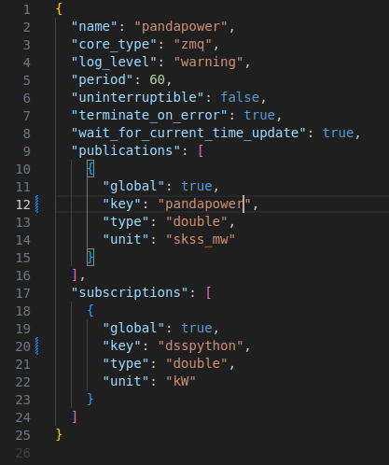
Pandapower config
Used to be pandapower/current
Changed to just pandapower

Slide 13
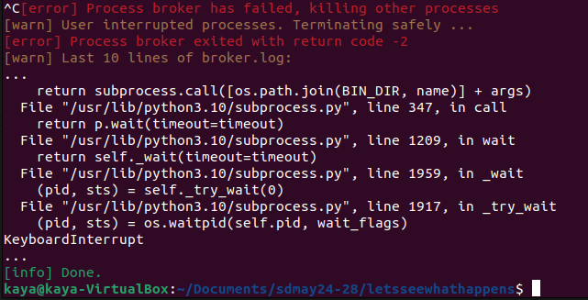
Resulted in infinitely creating DSS file results.

Slide 14
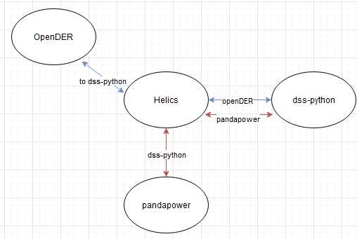
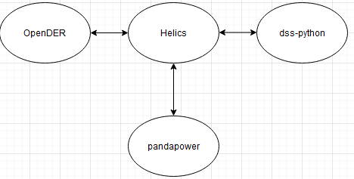
https://github.com/NREL/dss-cosim
OpenDER and OpenDSS helics co-simulation
Question:
Would this be a good implementation to follow to get OpenDER and DSS connected?
If so, would we need a three way helics implementation with DER and dss-python communicating, and then dss-python and pandapower?

Slide 15
Work-Tommy
Looked at GitHub for OpenDER
Explored examples from GitHub, not much learned
Not yet able to run examples, shown on next slide
Received help from Kaya and Justin to set up personal VM
Future Plans
Need more help to set up and run DER so I can understand more and hopefully get cosimiluation examples with OpenDSS

Slide 17
Next Week's Plan

